Slide 1
Keyword Driven Testing Dhwani patel MS-CIS Software Engineering
A keyword-driven test is an executable collection of keywords

Slide 2
Keyword-Driven Testing ^{[1]}
Type of functional automation testing framework known as table-driven testing or action word based testing.
Is a software testing methodology that separates test design from test development.
A keyword-driven test can be played back just like any other test.

Slide 3
Test case framework division ^{[3]}
Test step: description of action going to perform on test object.
Test object: it is the name of the web page object like username and password.
Action: is the name of action, which is going to perform on any action such as click, open browser, input, etc.
Test Data: Data can be any value which is needed by the object to perform any action, like username value for username field.

Slide 4
Project Goals
Design and Integrate keyword-driven automation framework into Selenium Web Driver™.
Develop a keyword vocabulary for specifying an individual keyword testing action like ‘mouse click’, selection menu, keystrokes, opening or closing browser and other actions.
With help of keyword driven framework, I will automate the following test scenarios of web form.

Slide 5
Process Method
Define the vocabulary to define certain amounts of keywords.
Parse the test case or file.
Interpret the sequence of keywords.
For each keyword:
Call the respective commands or script or function, which execute the action related with the keyword
4. Provide execution results at the keyword level.

Slide 6
To Achieve Task ^{[2]}
Excel Sheet: this sheet keeps most of the data for keyword driven which is used for the test like Test Case, Test Steps, Test Objects and actions.
Object Repository: this file store the html elements properties of the web application, linked with objects in the test.
Keyword Function Library: it stores the working of the action, so that each action can be callable from this file.
Data Sheet: excel file to store the data value needed by the object to perform some action in it
Execution Engine: Test is the only script is there on Keyword framework and it contains all the code to drive the test from excel sheet, function library and properties files.

Slide 7
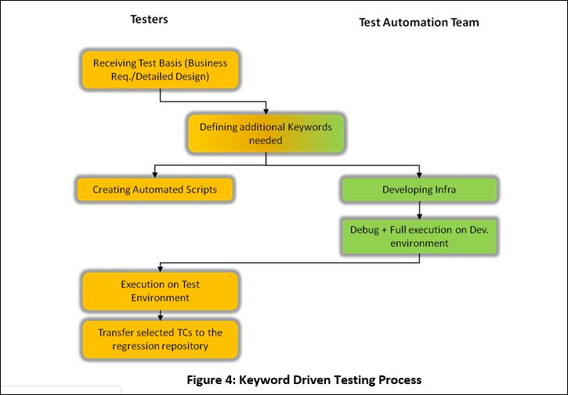
Process Flow

Slide 8
Success
With the help of the Selenium Web Driver, keyword-driven framework will generate automated test cases in excel sheets with the test results.
Easy to maintenance of keywords as compare to programming scripts.
Overall testing process takes less time.
Also reduce the cost of testing by using the open source tool.

Slide 9
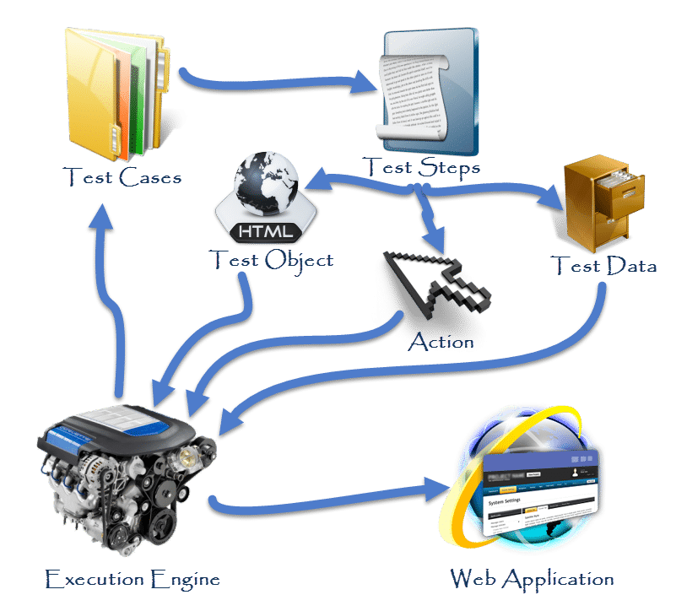
Project Plan:
Project Goal 2
Project Goal 1
Execution Engine starts the test and connect with the bundle of test cases and start executing one by one
Once Test Case is picked, linked test steps are followed sequentially
Test Steps are further connected with Page Objects, Actions & Test Data
Once Execution Engine gets all the required info to perform a test step, it connects with application and do the step.
Project Goal 1.2
Project Goal 1.1
Project Goal 1.3
Project Goal 3

Slide 10
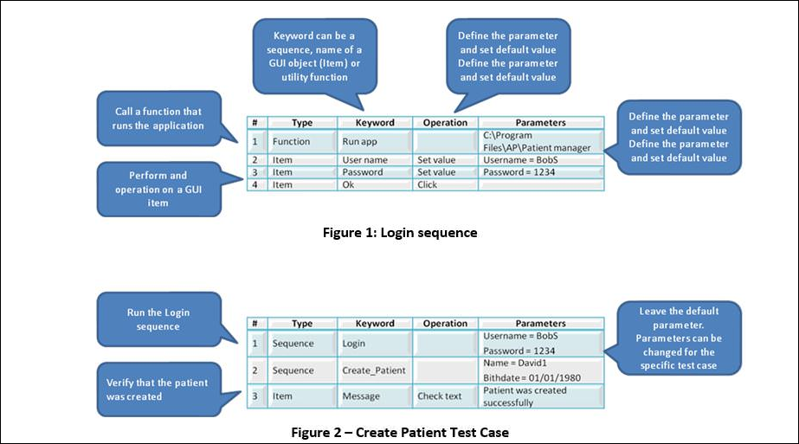
Example:

Slide 11
Tools:
Open Source Website
Selenium Web Driver™
Language: PHP or JAVA
MySQL
Server

Slide 12
Citations
[1] Rashmi, and Neha. “A Keyword Driven Framework for Testing Web Applications.” International Journal of Advanced Computer Science and Applications (IJACSA), vol. 3, Mar. 2012, pp. 8–14.
[2] Singhal, Shreya, and Harpreet Kaur. “Selenium Keyword Driven Testing Framework.” International Journal of Advanced Computer Science and Applications (IJACSA), vol. 4, no. 6, June 2014.
[3] http://toolsqa.com/selenium-webdriver/keyword-driven-framework/introduction/

